Slide 1

SMART INDIA HACKATHON 2026
Problem Statement ID : SIH26145
Problem Statement Title : AI-Based Detection of
Threats in Unidirectional IP Traffic
Theme : Blockchain & Cybersecurity
PS Category : Software
Team ID-
Team Name - EigenThinkers

Slide 2
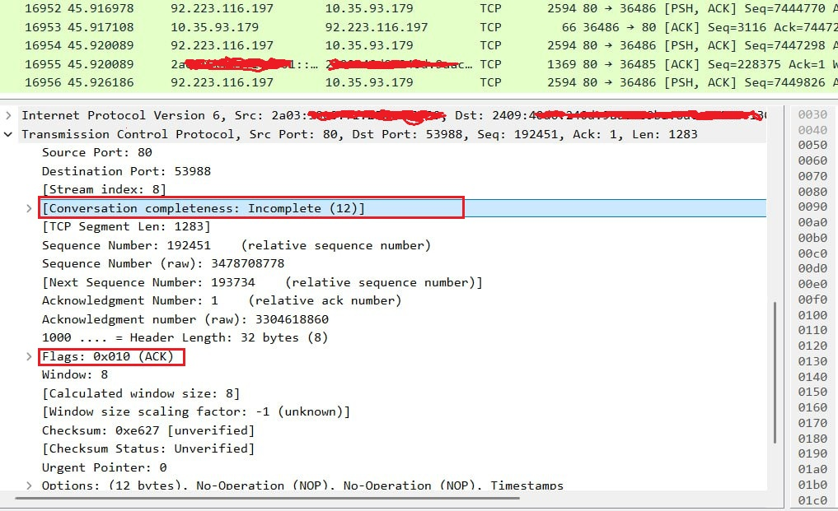
UniAethel
EigenThinkers
The Problem
Our Solution
A Stateless Parallel-Triage Engine : A passive behavioural-intelligence engine that continuously learns the normal communication fingerprint of the network traffic and detects when that behaviour deviates or evolves toward a threat.
Failure of Traditional IDS Systems in critical networks like Military Sytems & Power Grids protected by data diodes, traffic is mirrored into an isolated monitoring enclave in one direction only. IDS requires sending probes, complete handshakes, push mitigation commands Therefore
Blind to offline zero-days & Encrypted TLS C2 CHANNELS
Such Airgapped environments make Static signature database based mechanism obsolete.
Target Attack Vectors
Supply Chain Compromise Vectors
Encrypted Traffic Threat Vectors
Offline Air-Gap Bypass Vectors : Physical Malware Implants . e.g. Stuxnet etc
C2 Beaconing , DDos, Reconnaissance, Data Exfiltration
Core Novelties
Parallel Multidomain Behavioural Fingerprinting :
Combines 4 concurrent analytical engines. Statistical + Geometric + Temporal + Topological. i.e combines statistics + time + topology + metadata
Trajectory Intelligence : Predicts what the attack is becoming
Zero-Day Resilience : Fully unsupervised system requiring no pre-existing signature databases
TCN based C2 Detection : Flags covert algorithmic beacons hiding behind jitter

Slide 3
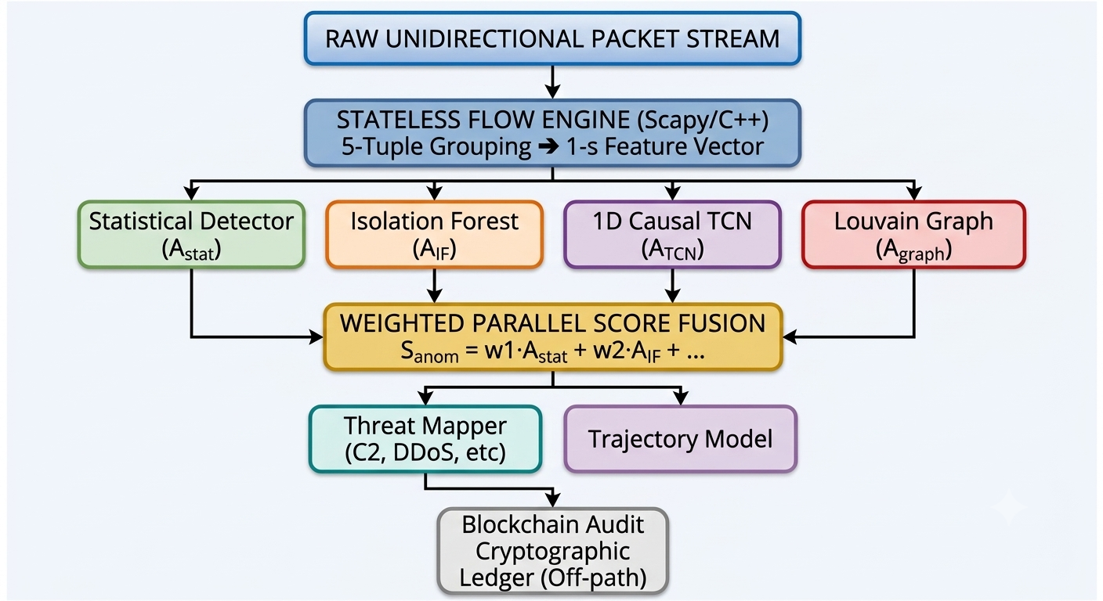
TECHNICAL APPROACH
EigenThinkers
RAW UNIDIRECTIONAL PACKET STREAM
STATELESS FLOW ENGINE (Scapy/C++)
Isolation Forest (A_{IF} )
Louvian Graph (A_{graph})
WEIGHTED PARALLEL SCORE FUSION
1D Casual TCN (A_{TCN})
Threat Mapper
(C2, DDoS, etc)
Trajectory Model
Blockchain Audit Cryptographic Ledger (Off-Path)
Statistical Detector (A_{stat} )
S_{anom}=
w₁*A_{stat}+w₂*A_{IF} + …

Slide 4
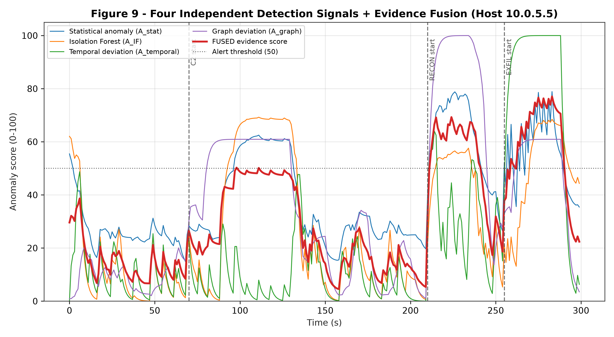
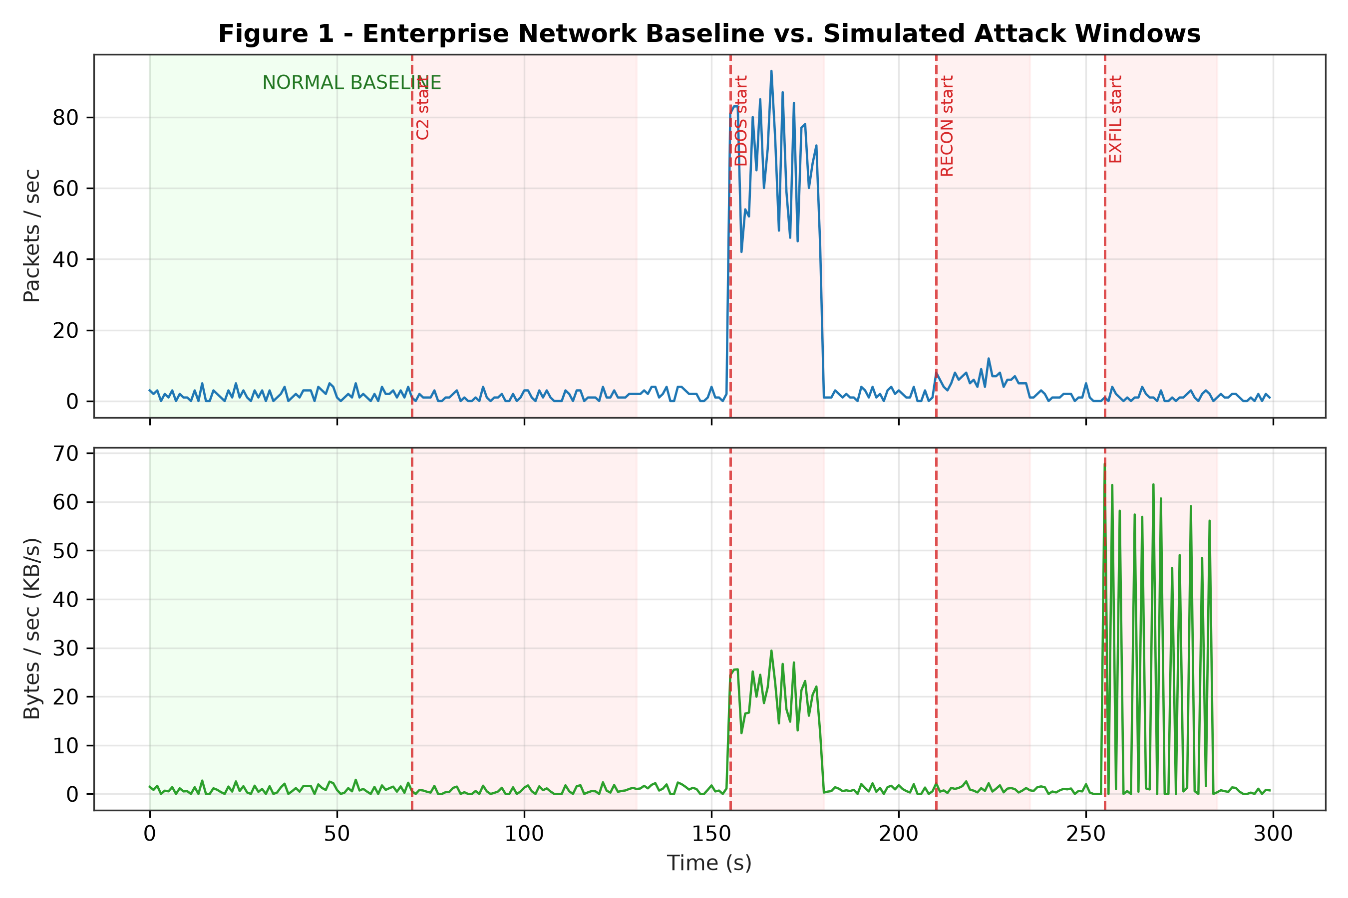
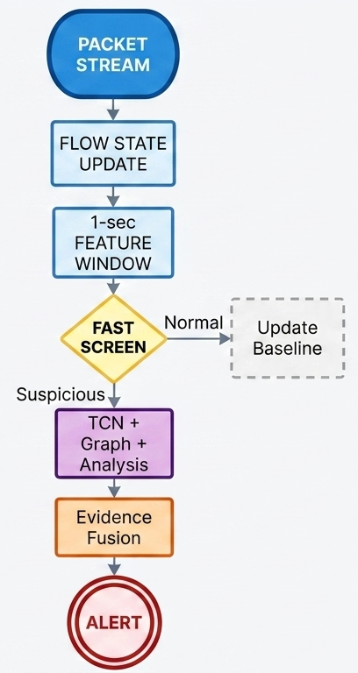
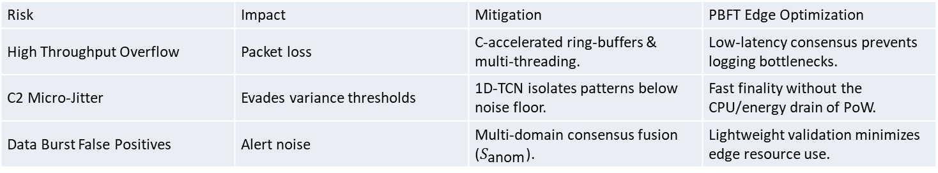
FEASIBILITY AND VIABILITY
EigenThinkers
Prototype
VALIDATION ( ATTACK SIMULATION )
Implementation
Scapy/Flow extraction ,NumPy/Pandas ,PyTorch, NetworkX , FastAPI, React
Challenges, Risks and Mitigations
Risk | Impact | Mitigation | PBFT Edge Optimization
High Throughput Overflow | Packet loss | C-accelerated ring-buffers & multi-threading. | Low-latency consensus prevents logging bottlenecks.
C2 Micro-Jitter | Evades variance thresholds | 1D-TCN isolates patterns below noise floor. | Fast finality without the CPU/energy drain of PoW.
Data Burst False Positives | Alert noise | Multi-domain consensus fusion ($S_{\text{anom}}$). | Lightweight validation minimizes edge resource use.

Slide 5
IMPACT AND BENEFITS
EigenThinker
Target Audience (NTRO / Defense ):
PRACTICAL IMPACT
BENEFITS
DEFENCE & GOVERNMENT
AIR-GAPPED COMPLIANCE : Monitor isolated / Critical Infrastructure networks without weakening isolation or being invasive
SOC OPERATIONS
Receive alerts with confidence + evidence + predicted progression, rather than opaque attack labels.
DIGITAL FORENSICS
Evidence Logging into blockchain guarantees tamper-proof audit trails for forensic investigations
Limitation | UniAethel
No return path | Passive detection
Cannot actively verify | Behavioural inference
Payload unavailable | Metadata-based analysis
Trusted destination may be abused | Behaviour-change detection
Unknown attack | Open-set anomaly detection
Single weak indicator | Evidence fusion
Only detects current event | Attack-trajectory prediction
Evidence can be altered | Tamper-evident provenance

Slide 6
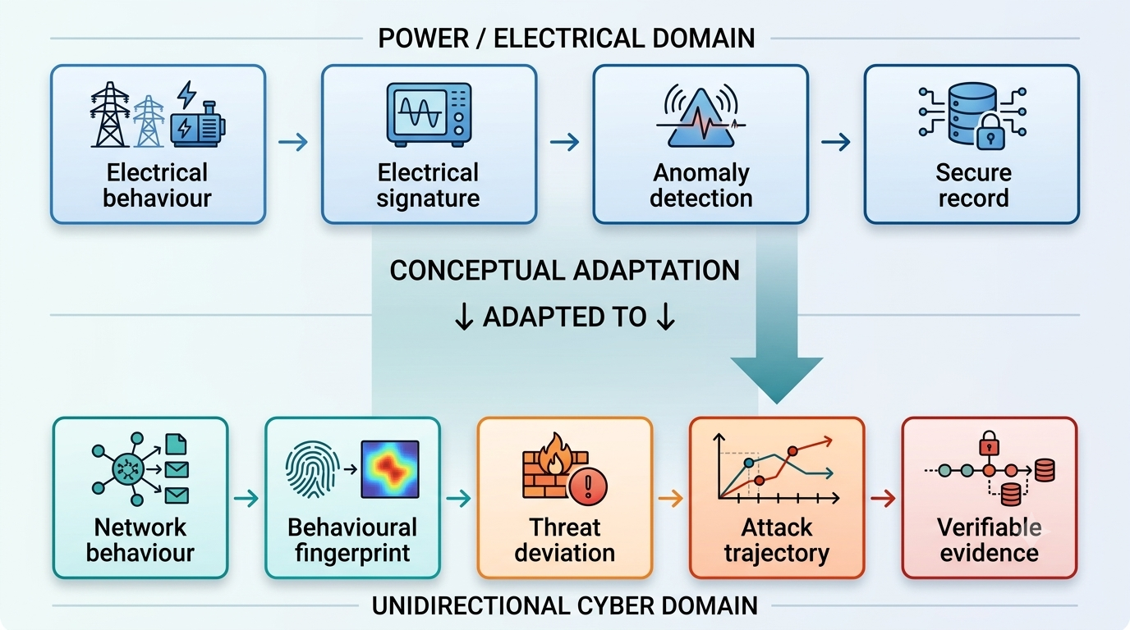
RESEARCH AND REFERENCES
EigenThinkers
Inspired by Previous Research Manuscript | 2024-2026
“A Novel Blockchain Based Energy Anti-Theft System Advanced with Machine Learning Algorithm for Real-Time Anomaly Detection”
ADAPTION
EXTERNAL VALIDATION & RECOGNITION
IRIS 2024
Research verification / recognition
FITT · IIT Delhi - 2025
External research/innovation validation
Samsung R&D - 2025
Technical evaluation / engagement
Samsung Solve for Tomorrow 2025
Top 20 Grand Finale Finalist
₹1 lakh development grant
REFERENCES:
https://github.com/SAMEER-MLPROJECT/PREVIEW

